Slide 1
Intro to neural networks
Content created by: Francesco Pinto, Linde Hesse, Tom Joy, Csabi Botos, Christina Winkler, Mélanie Roschewitz, Owais Hussain

Slide 2
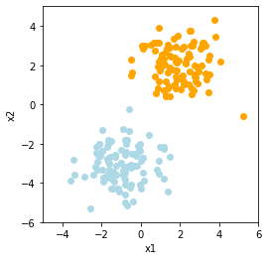
Recap
Logistic regression is a classification model
We can separate two classes using a linear decision boundary
For new data points, we want to predict the probability of the point belonging to class 1 or 2.
Spam vs Non-Spam Email
Regular vs fraudulent transaction

Slide 3
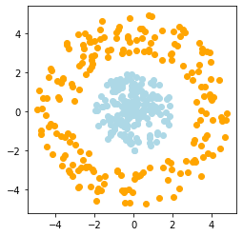
Non-Linearly Separable Classes
What would happen if we apply logistic regression to this data?
Draw any line, in any way. The classes are not separable by a linear decision boundary.

Slide 4
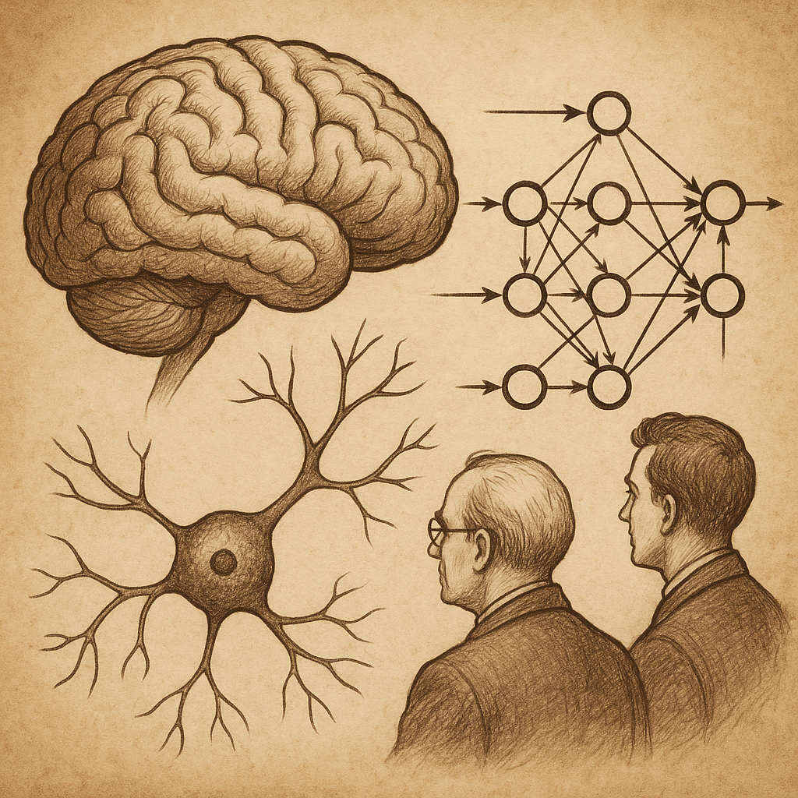
What if we try to imitate the human brain?
To make a computer learn like humans, we need a model like brain.
The brain processes information by having billions of interconnected neurons.
Many simple interactions can solve complex tasks.
Can we translate this concept to teach a computer to learn complex patterns ?

Slide 5
Building blocks of a neural network

Slide 6
Some necessary jargon
Neuron: a function that can receive inputs from other connected neurons and produce an output.
Perceptron: single-layer neural network that can solve linearly problems, but not complex ones.
Weights & Biases: parameters defining strength of connections.
Propagation Function: to transfer data across different layers of neurons.
Learning Rule: method to adjust weights and biases to improve accuracy.

Slide 7
Neuron
Imagine a group chat:
Users send messages to an Admin (Neuron)
A certain number of users say: “Let’s meet on Monday” (input).
If the number of users meets certain threshold, then the admin sends a message “There’s a meeting on Monday”.
If the incoming messages are below the threshold, the admin does nothing.
So, a neuron collects “votes” from other neurons. If the votes are enough, it sends its own message.

Slide 8
Weights & Bias
Weights: tell the Admin how much value each incoming message has.
Admin doesn’t treat all users all same. For him, each message carries different weight from 0 to 1.
Admin scores the incoming messages (multiplies each message by its weight), then adds up all the scores.
Weight of a message may depend on any factor, like seniority, availability, ties with other users, etc. depending on what the voting is for.
Weights are not fixed, in one poll, a user may have a higher weight than other polls.
Bias: the Admin’s default tendency to send a message or stay silent, regardless of the scores.
In some situations, Admin may remain silent. In others, he may be tempted to pass on a message 90% of the time.

Slide 9
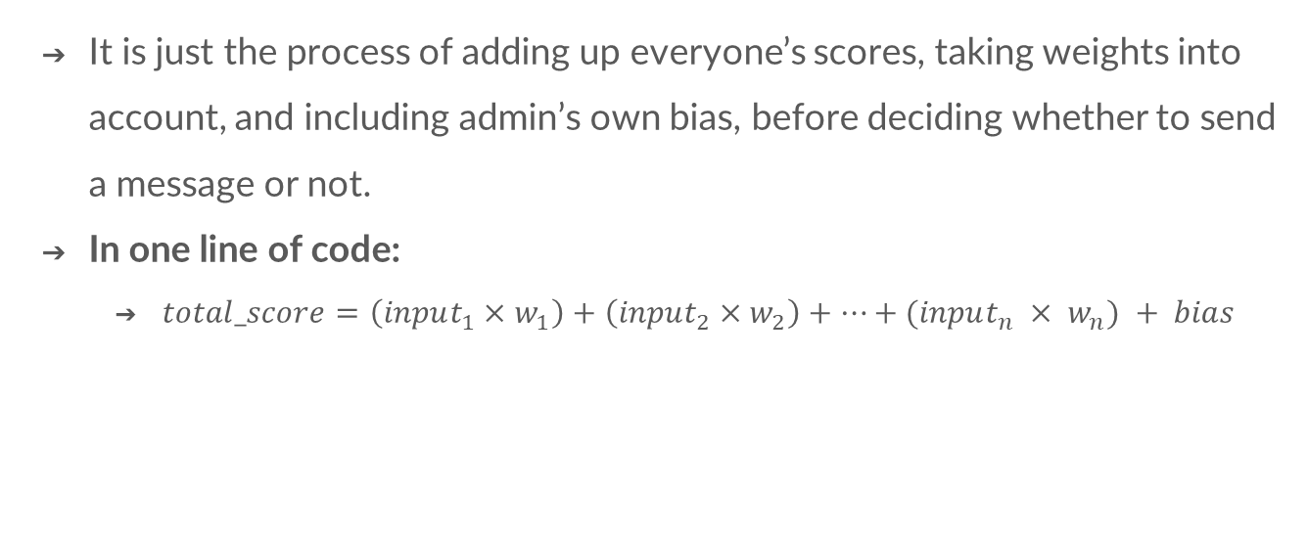
Propagation function
It is just the process of adding up everyone’s scores, taking weights into account, and including admin’s own bias, before deciding whether to send a message or not.
In one line of code:
$total_score=\left(input_{1}×w_{1}\right)+\left(input_{2}×w_{2}\right)+…+(input_{n} × w_{n}) + bias$

Slide 10
Learning Rule
Learning Rule is what makes the Admin a better Admin over time.
After each message sent, the admin looks back and thinks “Was it a correct decision?”
If the admin makes a bad decision, he adjusts weights, bias, or both:
I think user Aroob and Fatima were given too much weight. I should weigh their messages less next time.
I think user Ushna was given too little weight; I should weigh his messages more next time.
I think I’m restricting too much messages. I should adjust my bias to be more open next time.

Slide 11
Learning Rule
# Calculate the error
error = expected - prediction
# Update each preference (weight)
for i in range(len(weights)):
weights[i] += learning_rate * error * inputs[i]
# Update the bias
bias += learning_rate * error
Here, expected is what the decision should have been; prediction is the decision made; inputs are incoming messages; weights are weightages of inputs; bias is the admin’s overall preference to send message; learning_rate is how quickly the admin learns.

Slide 12




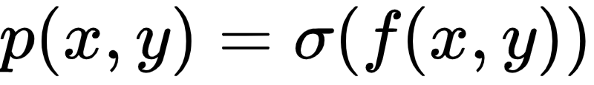
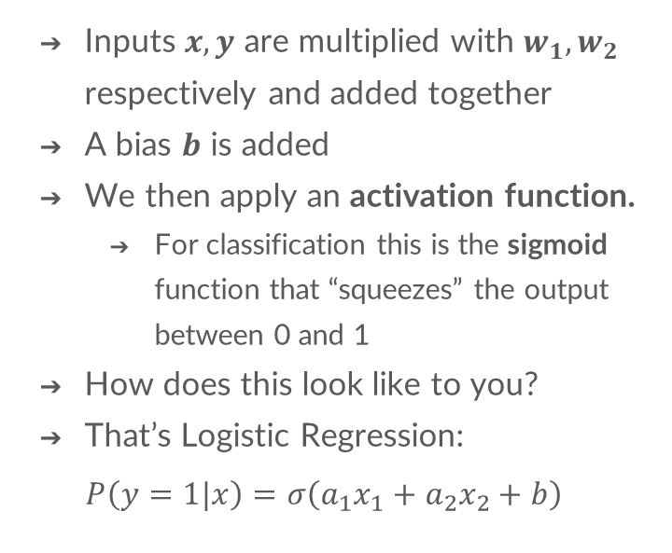
Computational Model of A Single Neuron
Inputs $x, y$ are multiplied with $w_{1},w_{2}$ respectively and added together
A bias $b$ is added
We then apply an activation function.
For classification this is the sigmoid function that “squeezes” the output between 0 and 1
How does this look like to you?
That’s Logistic Regression:
$$P\left(y=1|x\right)=σ\left(a_{1}x_{1}+a_{2}x_{2}+b\right)$$
x
f
y

Slide 13
Neural Network
An Artificial Neural Network is a collection of neurons chained together in two or more layers.
When all neurons follow the computational model explained earlier, the network is called Multi Layered Perceptron (MLP)
Output
Hidden 2
Input
Hidden 1

Slide 14
Why does this work?
Imagine creating map of all places of interest Karachi city.
Option A is to find a highly knowledgeable person, say Ahmed, who has lived, travelled, done businesses, and dined out for decades around the city.
This person is then tasked to list all places he knows from his memory and experience.
Option B is to find a random person, say Babar, from each towns and ask them to do the same task.
Which option is likely to be better on city-wide scale?
Neural Networks are like many option B’s; many weak neurons join forces to build a strong network for complex classification tasks.

Slide 15
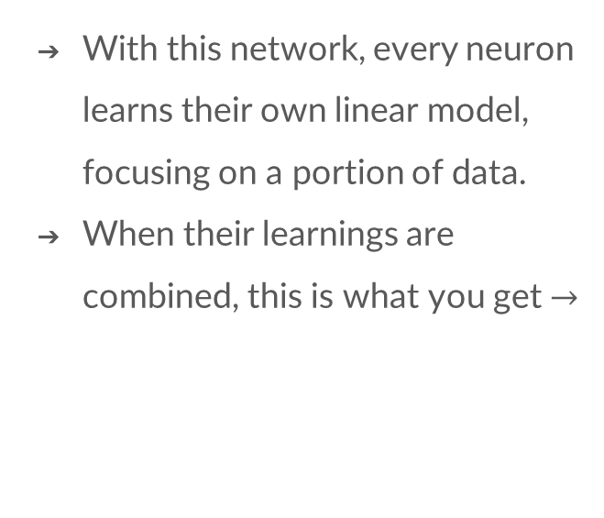
Why does this work?
With this network, every neuron learns their own linear model, focusing on a portion of data.
When their learnings are combined, this is what you get $→$

Slide 16
Why does this work?
The Neural Network is then trained for many epochs at certain learning rate.
Over time, the NN classifier learns to fit the data more accurately.
NOTE! This example is only to make you familiar with the broader idea. There is more detail that we will cover later.

Slide 17



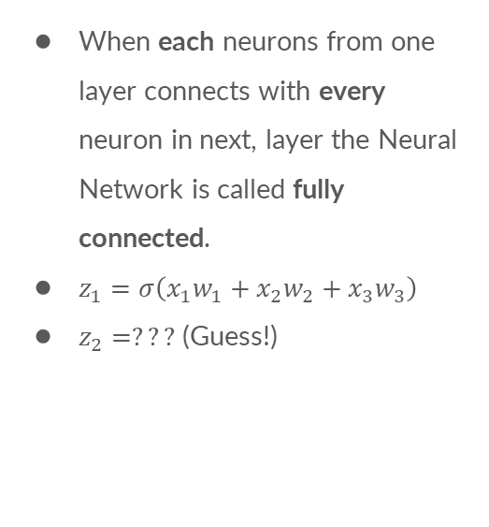






Neural Network
When each neurons from one layer connects with every neuron in next, layer the Neural Network is called fully connected.
$z_{1}=σ\left(x_{1}w_{1}+x_{2}w_{2}+x_{3}w_{3}\right)$
$z_{2}=???$ (Guess!)
$$w_{1}$$
$$z_{1}$$
$$x_{1}$$
$$w_{2}$$
$$w_{3}$$
$$z_{2}$$
$$x_{2}$$
$$y$$
Output
$$x_{3}$$
Hidden 2
Input
Hidden 1

Slide 18
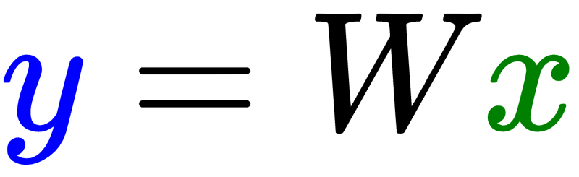
Neural Network in Matrix Notation

Slide 19
Designing a neural network

Slide 20
A single neuron is insufficient
x
f
y

Slide 21
How can a network separate the classes?

Slide 22
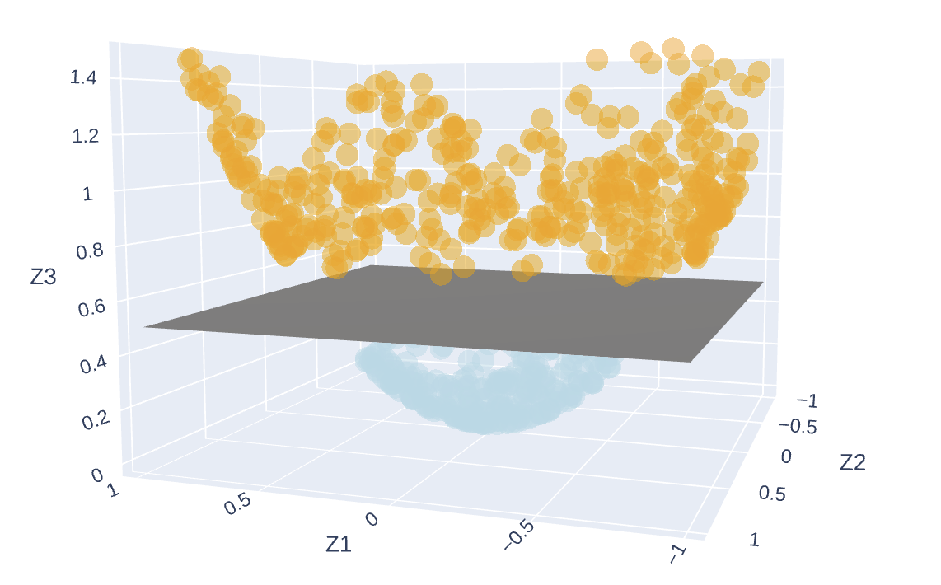
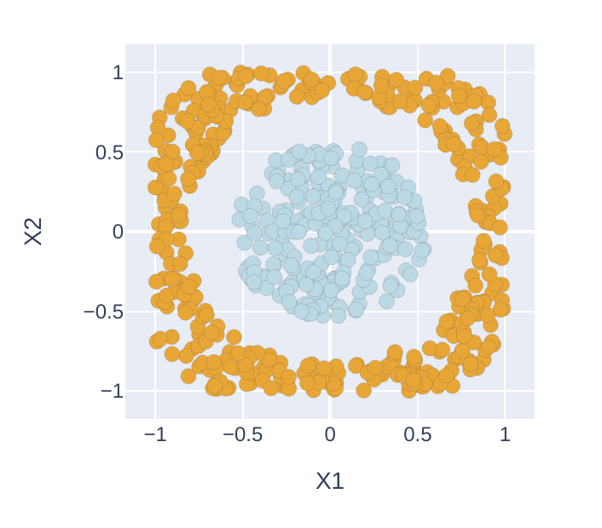


Representation learning
Hidden layers allow the NN to view the data in separate space. Each neuron in hidden layer adds a new dimension to project data. $Φ$ is a mapping function which converts data into a different space.
$$Φ$$
$$Φ^{−1}$$

Slide 23
Representation learning
Rather than learning a non-linear model, we see if a linear model can be learned if the data is projected into a different space.
Transforming the data from one space into another is computationally challenging. We use Kernel trick to address this issue.
Kernel is a function that can represent data from a lower dimension into higher dimension using dot product.
The classification is then performed on this higher dimension.
Notes:
It’s important to note that the input data itself is NOT converted into higher dimension, thanks to Kernel functions, it is only mapped to a higher dimension using dot product.

Slide 24
Example in action
The layers of a network map the input data to higher dimensional space
In this final representation the classes can then be separated by a plane.
Credit: Chris Olah's blog

Slide 25
A Neural Network
In first step, the input is represented in higher dimensional space, we call this representation learning or feature extraction.
For complex data, we need more than one layer (even hundreds) to have a good representation.
In the last layer, logistic regression is applied to obtain the output “probabilities”.
Representation Learning
Logistic Regression

Slide 26
Training a Neural Network using Scikit-learn
Objective 1: Using Scikit-learn, train a Neural Network on the Iris dataset.

Slide 27
Thank you!
You have just:
Learnt about neural networks, the most important and widely used model today.
And now time to get some hands on experience!!
Learn how to train a complex neural network model in Python using both the Iris dataset and the house pricing dataset!
Have fun and don’t hesitate to ask questions to all the helpers!
Please share your feedback!

